Slide 1
UCI machine learning Repository
Breast cancer Wisconsin (Diagnostic) Data Set
Downloaded: February 6th, 2020

Slide 2
Two datasets
Dataset I – Predicting Benign vs Malignant (198 cases)
Dataset II – Predicting Recurrent vs Non-recurrent (569 cases)
Four (4) Machine Learning Algorithms
Training Set : Test Set ratio = 80:20, Probability Cut Off Value = 80%
Kernel Support Vector Machine (SVM)
Artificial Neural Network
Random Forest
XGBoost

Slide 3
Results
 | Dataset I % Accuracy | Dataset II % Accuracy
Kernel SVM | 95.6 | 79.5
Artificial Neural Network | 96.5 | 79.5
Random Forest | 97.3 | 82
XGBoost | 100 | 100

Slide 4
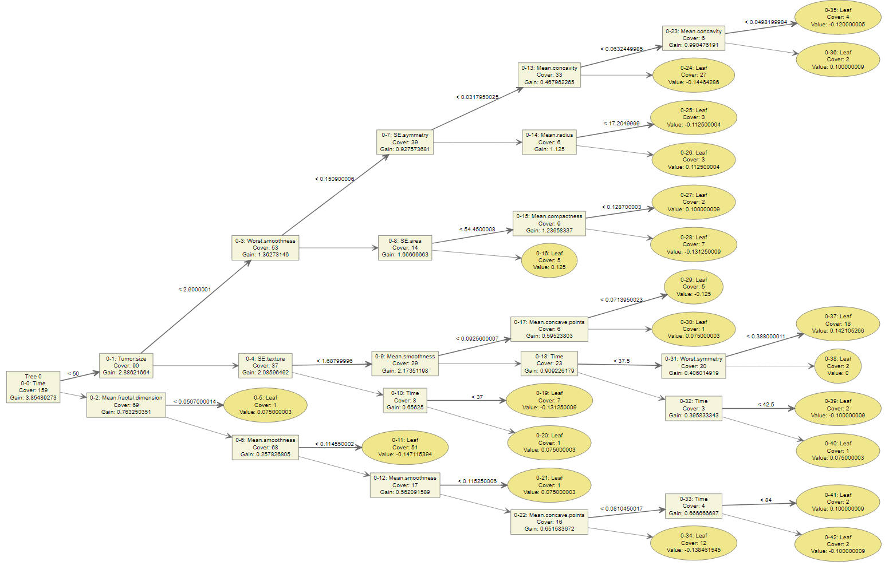
Tree from XGBoost model

Slide 5
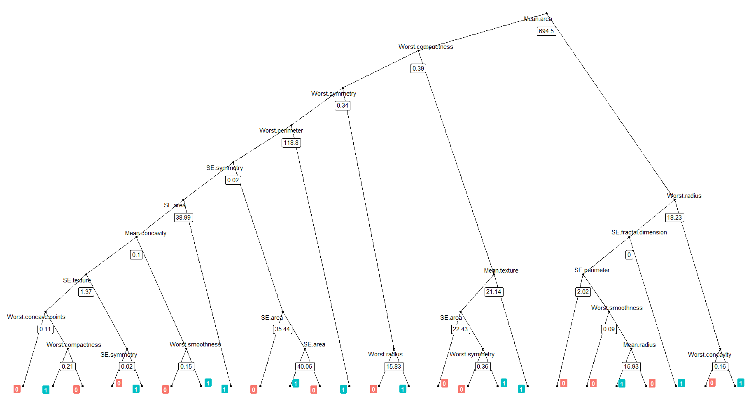
Tree from Random Forest model

